Slide 1

Movie Recommendation App
Movie Recommendation App that makes it easy for users to find movies, watch trailers, and get detailed information about their favourite films, all with the help of modern technology.
Notes:
Good [morning/afternoon], everyone! Today, I'm really excited to present the Movie Recommendations App; in this app, users are able to discover, view, and manage their favourite movies. This app actually uses modern technologies, such as the TMDB API and Firebase, to provide a rich experience for users. Now, through this presentation, I am going to take you through the app’s purpose, app features, technical aspects, and how it makes the lives of users much easier in movie discovery. I trust you will find this beneficial and inspiring; I look forward to the questions at the end.

Slide 2




Introduction to the Movie Recommendation App
Discover, Watch, and Manage Your Movie Experience
Definition of the Movie Recommendation App
The Movie Recommendation App is a mobile app that helps users find new movies, watch trailers, and easily manage their favourite lists.
Key Features Utilizing TMDB API
A key feature of the app is the use of the TMDB API, which gives users personalized movie recommendations based on what they like and watch. This makes sure the suggestions match their interests.
User Convenience with Firebase
The app uses Firebase to make logging in and saving data easy and secure. Users can log in, save their favourite movies, and access their lists from any device, ensuring a smooth experience.
Purpose of the App
The main goal of the Movie Recommendation App is to make it easy and enjoyable to find and explore movies. With smart technology and user-friendly design, it enhances how users connect with movies.
Notes:
The Movie Recommendation App is designed primarily for movie lovers who enjoy finding, watching, and organizing the films they love efficiently. With features like custom recommendations, trailers, and additional features on the movie page, the app really lets the user explore movies interactively and enjoyably. The modern design creates a user interface that is intuitive enough so that users, irrespective of age, are able to go about enjoying its features. The app incorporates powerful technologies such as TMDB API and Firebase. This makes the app innovative, reliable, and secure with its services. Let’s go ahead and see how this app simplifies and enhances the movie experience.

Slide 3

Features Overview
Explore the key functionalities and benefits of our movie application.
User Authentication
Movie Details
The app uses Firebase for secure login, signup, and password recovery, keeping user data safe with the latest security measures. This builds trust and makes it easy to access the app.
The app provides detailed movie info, like the synopsis, cast, and reviews. This helps users learn more about movies and decide what to watch.
Movie Discovery
Trailer Playback
The app connects with the TMDB API, letting users easily find trending and popular movies. With real-time updates and a huge library, it’s simple to discover your next favorite film.
Users can watch trailers right in the app using WebView. This makes it easy to see previews without needing to leave the app, improving the overall experience.
Favorites Management
Users can save and access their favorite movies with Firebase, making the app more personal. This feature makes it easy to find your favorite titles and improves the overall experience.
Notes:
This application contains multiple features that improve overall usability. Account sign-in and sign-up facilities using Firebase provide a secure and premium way to access accounts. Movie discovery features depend on the TMDB API and allow users to discover trending and popular movies within reach. The users may save and manage their favorite films via the Favorites Management system. With in-depth movie info, as well as its trailer replayed on the app, thus, providing a wholesome exploration of the movies. These all function together seamlessly provide an experience that is personal, fun, and quite without hassles for users.

Slide 4





Technical Stack Overview
Detailed look at technology choices
Programming Language: Kotlin
UI Framework: Jetpack Compose
Backend Integration: Firebase
Kotlin is chosen for its modern features and compatibility with Android development, ensuring efficient and reliable code.
Jetpack Compose helps to create dynamic and responsive designs, making the app look great with less complicated code.
Firebase is used for easy user login and secure data storage. It’s reliable, scalable, and simple to integrate.
API: TMDB API
Additional Features: WebView
The TMDB API gives access to a large database of movie info, making it easy to add rich media content to the app.
Use WebView for in-app trailer playback, ensuring smooth video streaming without leaving the app.
Notes:
The app is built on a robust and modern tech stack to ensure optimal performance and user satisfaction. Kotlin, with its efficiency and Android compatibility, powers the app’s development. Jetpack Compose enhances the UI, making it visually appealing and responsive. Firebase handles backend processes, offering secure authentication and data storage. The TMDB API brings a wealth of movie data, enriching the user experience. Additionally, WebView is used for seamless trailer playback. Each technology has been carefully chosen to deliver reliability, scalability, and an exceptional user experience.

Slide 5

TMDB API Integration
Exploring the capabilities and implementation of TMDB API for movie and TV data
What is TMDB API?
The TMDB API is a detailed source of movie and TV show data, giving developers access to a wide range of entertainment information.
Fetching Movie Lists
The TMDB API lets users access movie lists like popular, trending, and upcoming films, helping apps show the latest entertainment options.
Displaying Detailed Information
In addition to lists, the API offers detailed info about each movie and TV show, including posters, descriptions, and genre classifications, enhancing the user experience.
Seamless API Integration
With Retrofit, a user-friendly HTTP client for Android and Java, developers can easily integrate the TMDB API in Kotlin. It simplifies making network requests and handling responses.
Notes:
TMDB has been a major element of the application. It provides a comprehensive database that consists of thousands of films and television shows, dynamic lists such as trending movies, upcoming movies, etc., as well as in-depth information about a movie, including posters, genres, and synopses, among other things. The Retrofit libraries of HTTP enable us to connect this API efficiently with a powerful network call and be able to have good data servicing. The connection enables users to experience content and much more according to their preferences. TMDB makes this possible.

Slide 6
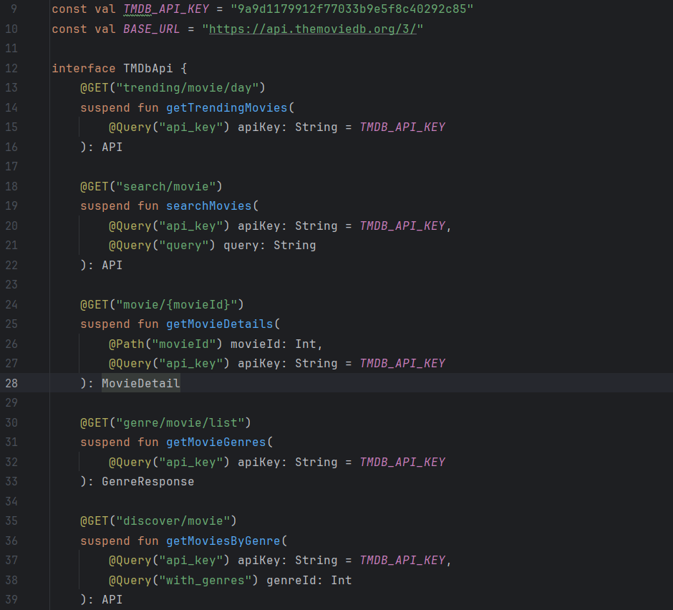
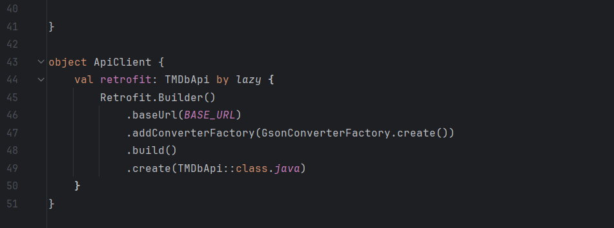
Notes:
This code demonstrates the seamless integration of the TMDB API using Retrofit. It fetches movie data like popular and trending lists, processes the responses, and displays them on the UI. The implementation ensures efficient network calls and adheres to best practices for maintainable and scalable code. This approach guarantees that users always access accurate and up-to-date movie information effortlessly, showcasing the app’s technical sophistication.

Slide 7




Firebase Integration
Exploring the advantages and implemented features of Firebase
Why Firebase?
Authentication Features
Firebase offers a secure and reliable system for user authentication and data storage, making it a popular choice for modern apps.
Firebase supports easy login, signup, and password recovery, improving both security and user experience.
Realtime Database
Scalability
Firebase’s Realtime Database makes it easy to store and access favorite movies, so users can quickly retrieve their information.
Firebase is built to handle many users efficiently, ensuring the app performs well even as it scales.
Notes:
Firebase plays a crucial role in the app’s functionality. It provides secure authentication features, including login, signup, and password recovery, ensuring a smooth and reliable user experience. Its Real-Time Database allows users to save and access their favourite movies seamlessly from any device. Firebase is also highly scalable, making it suitable for handling large user bases as the app grows. By integrating Firebase, we ensure that user data is managed safely and efficiently and confidence in users while providing a seamless and engaging app experience.

Slide 8
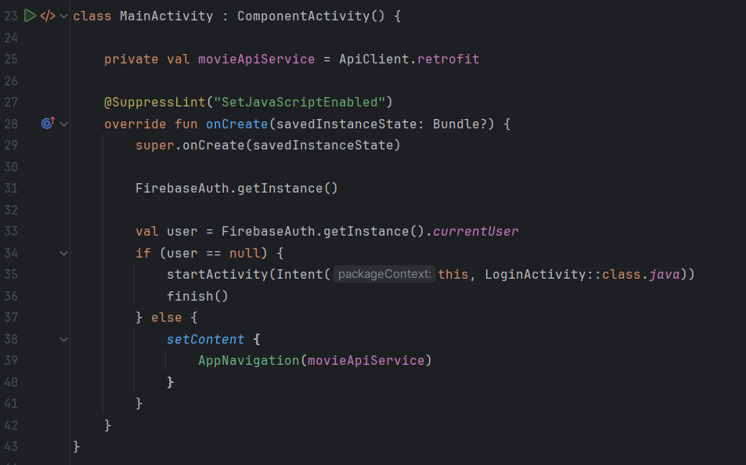
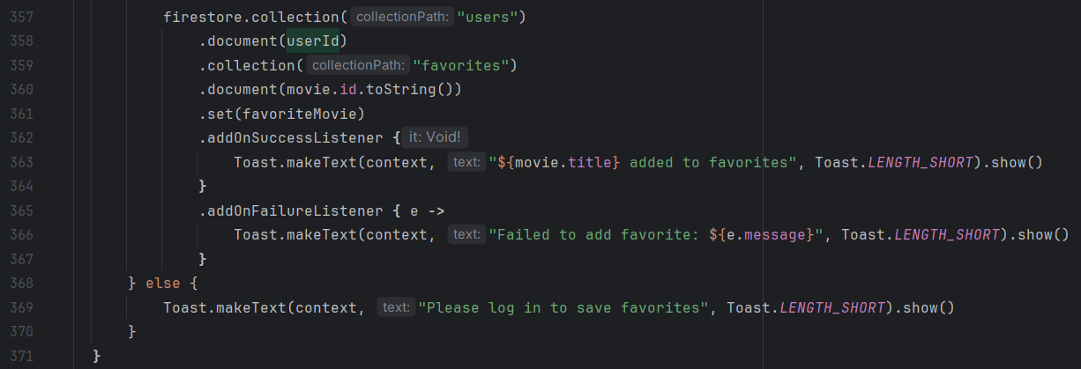
Notes:
Here, the code illustrates Firebase’s integration for user authentication and data storage. It includes functions for secure login, signup, and real-time data management. The implementation prioritizes security and reliability, ensuring user trust while maintaining high performance. By using Firebase, we’ve simplified complex backend processes, allowing the app to scale effortlessly as user demand increases.

Slide 9
Application Screens Overview
A Comprehensive Look at the Key Features of the Application
Login Screen
Signup Screen
Forgot Password Screen
Home Screen
The Login Screen helps users sign in securely, making it easy for returning users to access their accounts.
The Signup Screen lets new users create an account quickly so they can start using the app immediately.
The Forgot Password Screen helps users safely recover their passwords, keeping their accounts secure and easy to access.
The Home Screen acts as the main section of the app, helping users easily find and explore popular and trending movies.
Movie Detail Screen
Favorites Screen
WebView Screen
The Movie Detail Screen provides detailed info about movies, like ratings, reviews, and descriptions, improving the user experience.
The Favorites Screen lets users manage their favourite movies, offering a personalized viewing experience.
The WebView Screen lets users watch trailers via YouTube links, providing smooth access to multimedia content.
Notes:
The app’s interface has been designed for simplicity and functionality. The Login and Signup screens ensure secure access, while the Forgot Password screen provides an easy way to recover accounts. The Home screen highlights trending and popular movies for quick discovery. Detailed movie information, including ratings and reviews, is available on the Movie Detail screen. The Favorites screen helps users manage their favourite titles, while the WebView screen allows trailer playback directly within the app. Each screen is created to ensure an intuitive and enjoyable user journey.

Slide 10
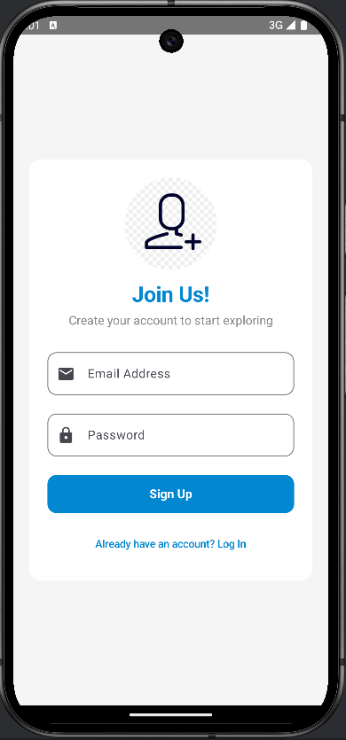
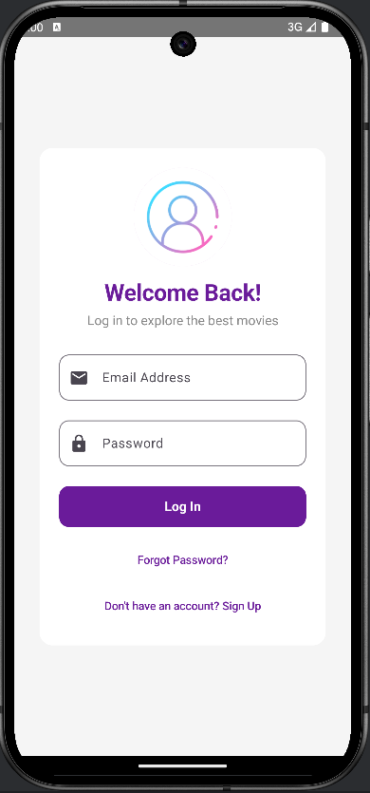
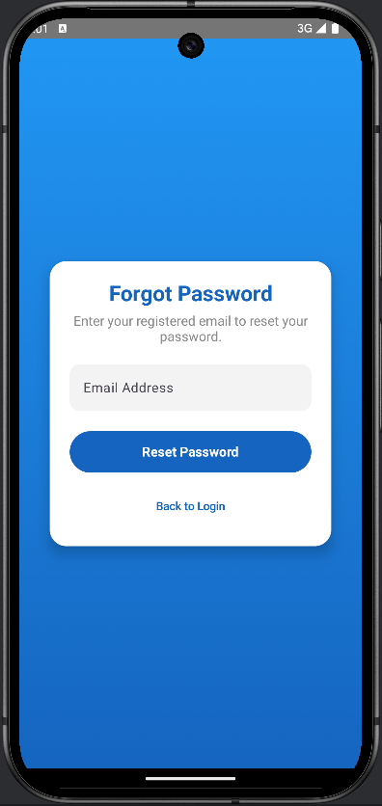
Notes:
The login screen seamlessly logs users into the app and grants easy but safe access to all users. Firebase authentication makes this very secure and user-friendly. It makes things relatively easy for returning users to log in with outstanding clarity and efficiency. Most importantly, it sets up the entry point into some amazing user experience functionalities of the app. It works at developing intense user trust and satisfaction. The signup screen is used to create new accounts for the users and verify their email by sending emails to their inboxes; the forgot password screen is used to recover the accounts of the existing users.

Slide 11
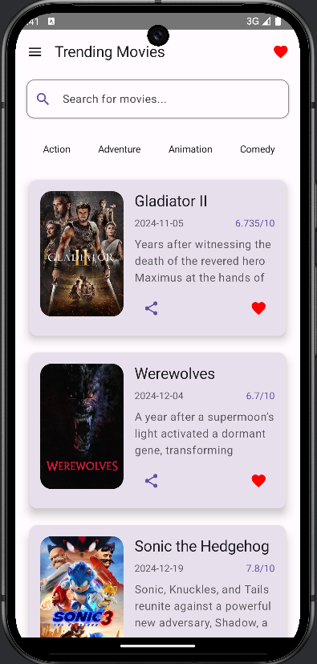

Home Screen Features
Explore the essential functionalities that enhance user interaction.
Displays lists of popular and trending movies
Search functionality for finding specific movies
Category Section to find movies according to categories
Notes:
This is the app’s Home Screen, showcasing popular and trending movies. It is designed for easy navigation, with a clean layout and intuitive search functionality. Users can explore categories to find movies that match their preferences. By displaying real-time data fetched from the TMDB API, the Home Screen ensures that users always have access to the latest and most relevant content, making movie discovery both engaging and effortless. It also has an add-to-favourite and share options feature, which enhances the user experience.

Slide 12
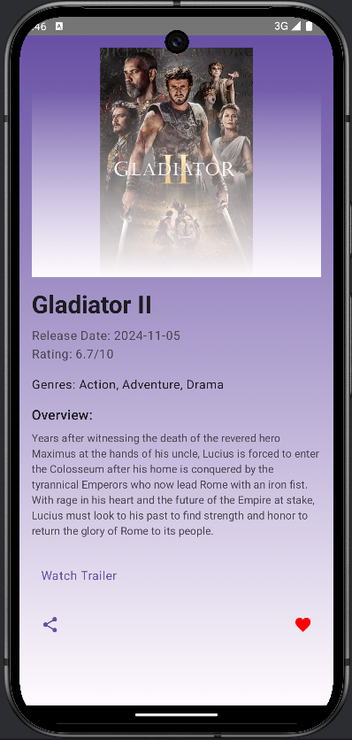
Comprehensive Movie Detail Screen
Explore the essential features that enhance user experience
Movie poster
Movie overview
Movie name
Movie trailer
Movie release date
Movie share option
Movie rating
Save to your favourite option
Movie genres
Notes:
The Movie Detail Screen provides detailed information about each film. It includes key details like the overview, cast, release date, ratings, and genres, helping users make informed choices. The screen also offers options to watch trailers, share movies, and save favourites. This comprehensive presentation of movie details enhances user engagement by making it easy to decide what to watch next, adding significant value to the app experience.

Slide 13
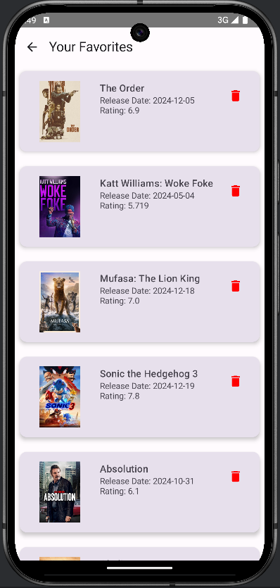
Favorites Screen
Key Features Enabling Enhanced User Experience
User-Friendly Movie Favorites Feature
Seamless Integration with Firebase
Flexible Management of Favorites
Notes:
The Favorites Screen lets users manage their saved movies effortlessly. Built on Firebase’s Realtime Database, it provides a secure and flexible way to store and access favourite movies. Users can revisit their favourite list anytime, which gives a personalised experience. The screen’s clean and organized design simplifies navigation, making it a key feature for enhancing user satisfaction and app loyalty.

Slide 14
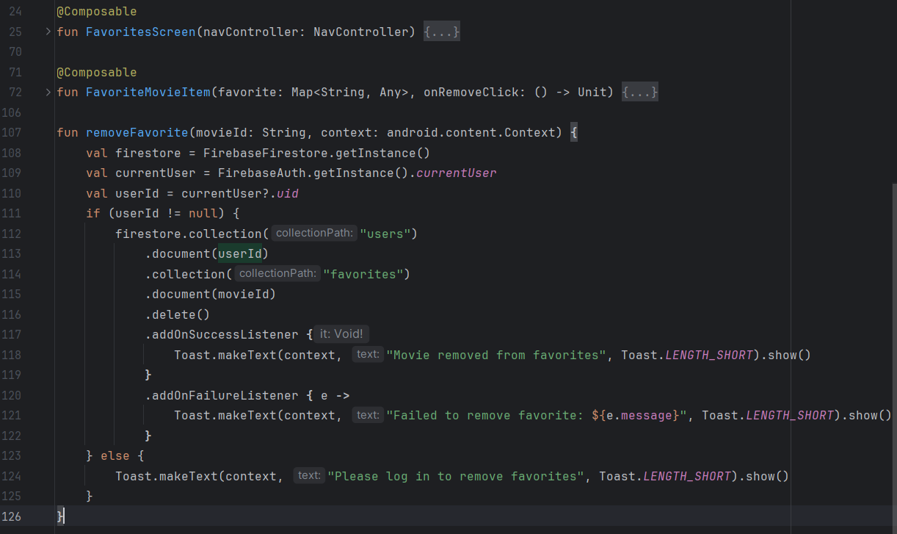
Notes:
This function, removeFavorite, handles the removal of a movie from the user's list of favourites in the Firebase Fire store. It first retrieves the current user's ID using Firebase Authentication. If the user is logged in, the function accesses the favourites collection under the user's document and deletes the specific movie by its movie ID. Success and failure callbacks are implemented to provide user feedback via toast messages, ensuring clear communication. If the user isn’t logged in, it displays a prompt to log in. This function highlights secure and user-friendly ways to manage data, enhancing the app’s personalized experience.

Slide 15
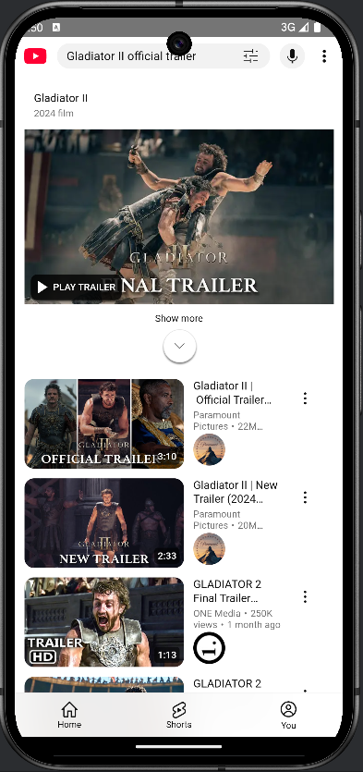
WebView Screen for Trailers
Enhancing User Experience with Multimedia Content
Integration of WebView
Fetch official Trailer on YouTube
Enhanced User Engagement by integrating multimedia content
Notes:
The WebView Screen opens the trailer from the application. It makes YouTube links directly into the screen, providing seamless multimedia experience. Instant access to movie previews draws users in because the app serves as a gateway to everything movie-related. This is an example of combining convenience with functionality to enhance the user experience.

Slide 16
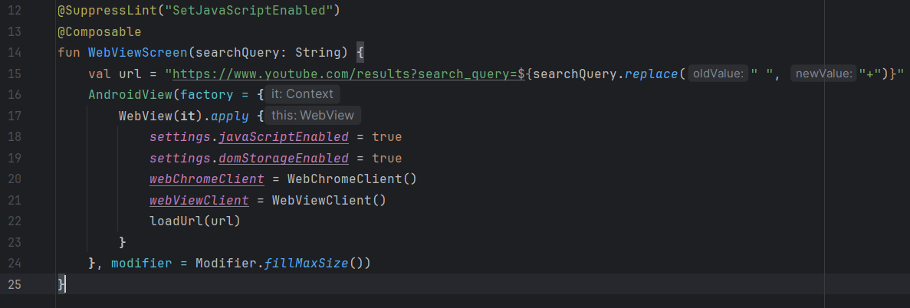
Notes:
Here, we have a WebView Screen function built using Jetpack Compose to display YouTube search results based on a query. The function takes a search query, dynamically builds a YouTube search URL, and loads it in a WebView. To ensure a smooth browsing experience, we enable JavaScript and DOM storage in the WebView settings. The WebView Client are set for handling web interactions and managing page loads. This code showcases how we integrate multimedia content seamlessly into our app, allowing users to view trailers or related videos directly without leaving the application. It's efficient and user-friendly.

Slide 17
Thank you! Feel free to ask your queries.

